Slide 1

Predicting Arrival

Slide 2
Motivation & Problem

Slide 3

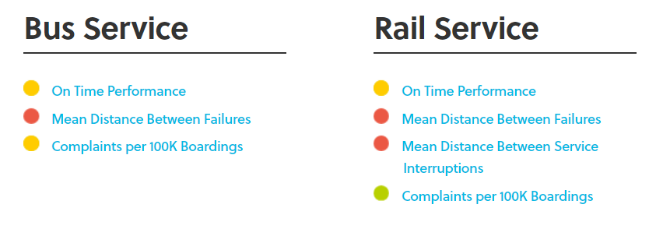
MARTA Problem
https://www.itsmarta.com/kpihome.aspx

Slide 4
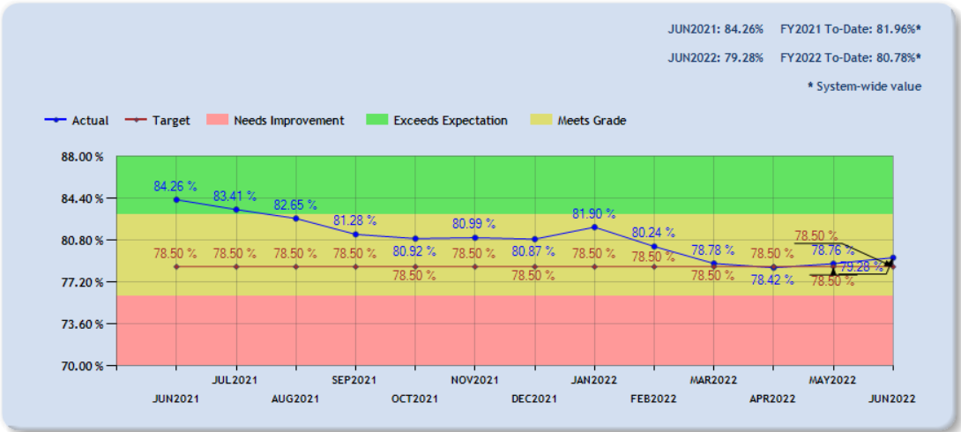
MARTA Problem
https://www.itsmarta.com/bsc_Bus_OTP.aspx

Slide 5
MARTA Problem
Marta riders have no information regarding bus delays !

Slide 6
Proposed Solution
Create a bus lateness predictor using MARTA’s public data

Slide 7
Data Used

Slide 8
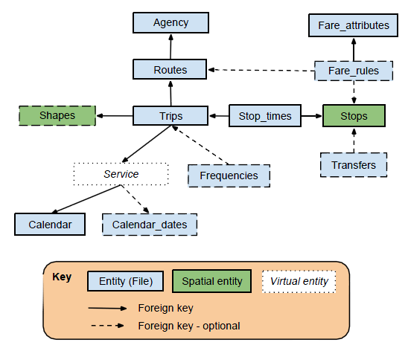
General Transit Feed Specification (GTFS)
What ?
Format for public transportation schedules and associated geographic information.

Slide 9
General Transit Feed Specification (GTFS)
What ?
Format for public transportation schedules and associated geographic information.
How ?
A series of text files collected in a ZIP file.

Slide 10
General Transit Feed Specification (GTFS)
What ?
Format for public transportation schedules and associated geographic information.
How ?
A series of text files collected in a ZIP file.
Why?
Public
Standard

Slide 11
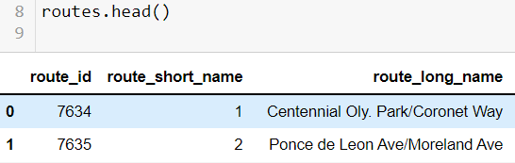
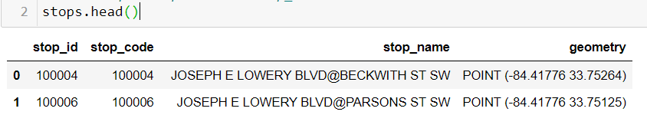
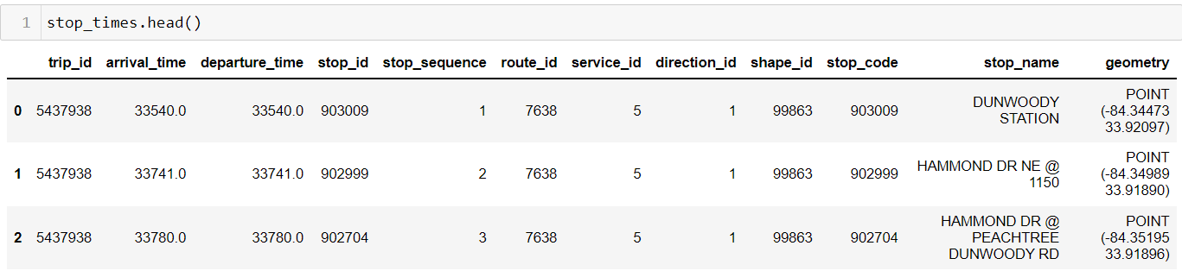
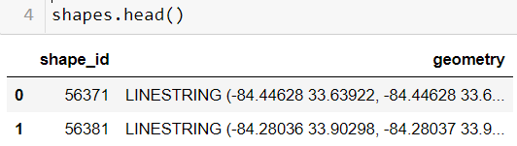
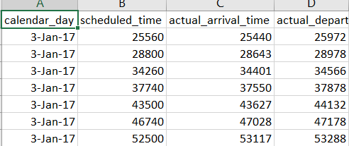
General Transit Feed Specification (GTFS)

Slide 12
General Transit Feed Specification (GTFS)

Slide 13
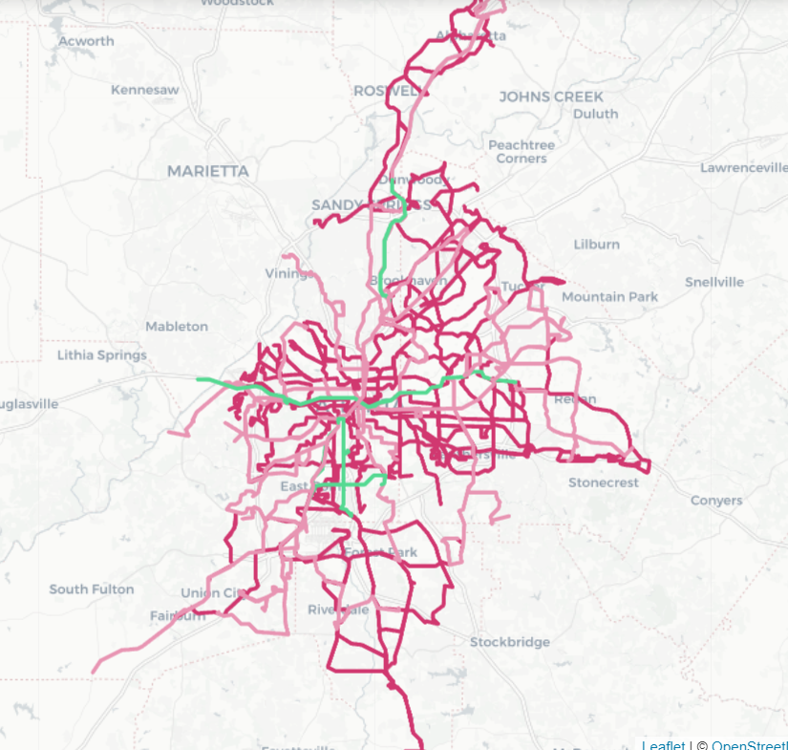
General Transit Feed Specification (GTFS)

Slide 14
Target Variable:
Arrival
In time
Not in Time
3 Minutes

Slide 15
Data Exploration & Preparation

Slide 16
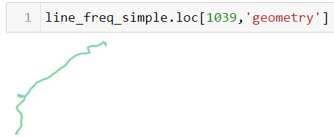
Dataset 1 vs Dataset 2
Dataset 1: Naïve Dataset
Full of categorical data
Did not utilize Geometry
Low Performance Metrics

Slide 17
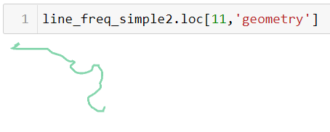
Dataset 1 vs Dataset 2
Dataset 2: Utilizing Geometry (Latitude, Longitude)
Number of nodes
Start Position
End Position
Length
Minimum Clearance (Robustness of Geometry)
Hausdorff Distance (Distance from Centroid )

Slide 18
Dataset 1 vs Dataset 2
Dataset 2: Utilizing Geometry (Latitude, Longitude)
Number of nodes
Start Position
End Position
Length
Minimum Clearance (Robustness of Geometry)
Hausdorff Distance (Distance from Centroid )

Slide 19
Dataset 1 vs Dataset 2
Dataset 2: Utilizing Geometry (Latitude, Longitude)
Number of nodes
Start Position
End Position
Length
Minimum Clearance (Robustness of Geometry)
Hausdorff Distance (Distance from Centroid )

Slide 20
Dataset 1 vs Dataset 2
Dataset 2: Utilizing Geometry (Latitude, Longitude)
Number of nodes
Start Position
End Position
Length
Minimum Clearance (Robustness of Geometry)
Hausdorff Distance (Distance from Centroid )

Slide 21

Normalizing:
Features
Normalize
Target
Enumerating the Names
Latitude and Longitude into spherical coordinates:
Day the week
Scheduled Stop time
Vehicle Number
Vehicle Route
Station
Station Order
Station sequence
Temperature
Stop Block (Side of the street)
Geographical Data
$$x=\cos\left(Latittude\right)×\cos\left(Longitude\right)$$
$$y=\cos\left(Latittude\right)×\sin\left(Longitude\right)$$
Not in time = 1
In time = 0

Slide 22
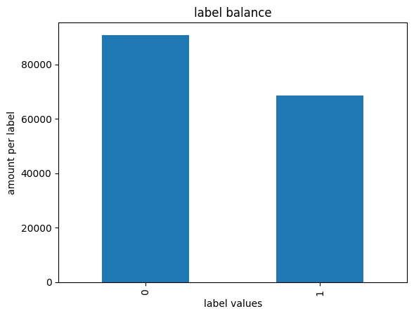
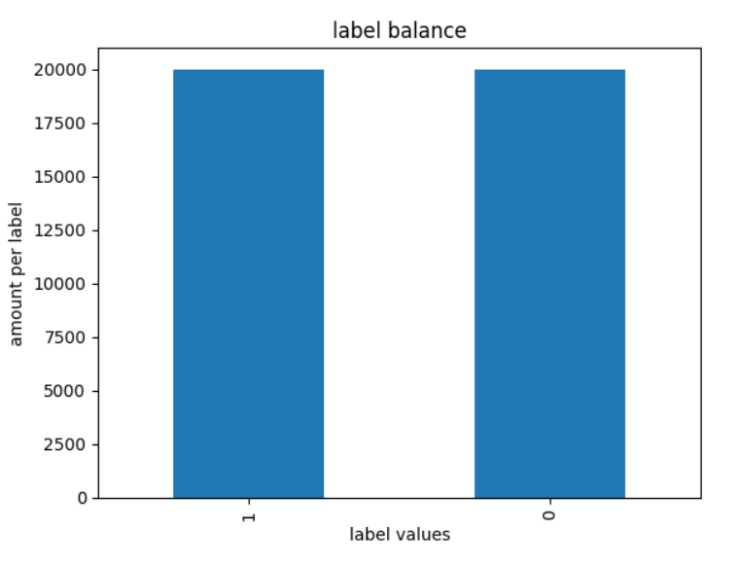
Target Variable:
Under sampling

Slide 23
Target Variable:
Under sampling

Slide 24
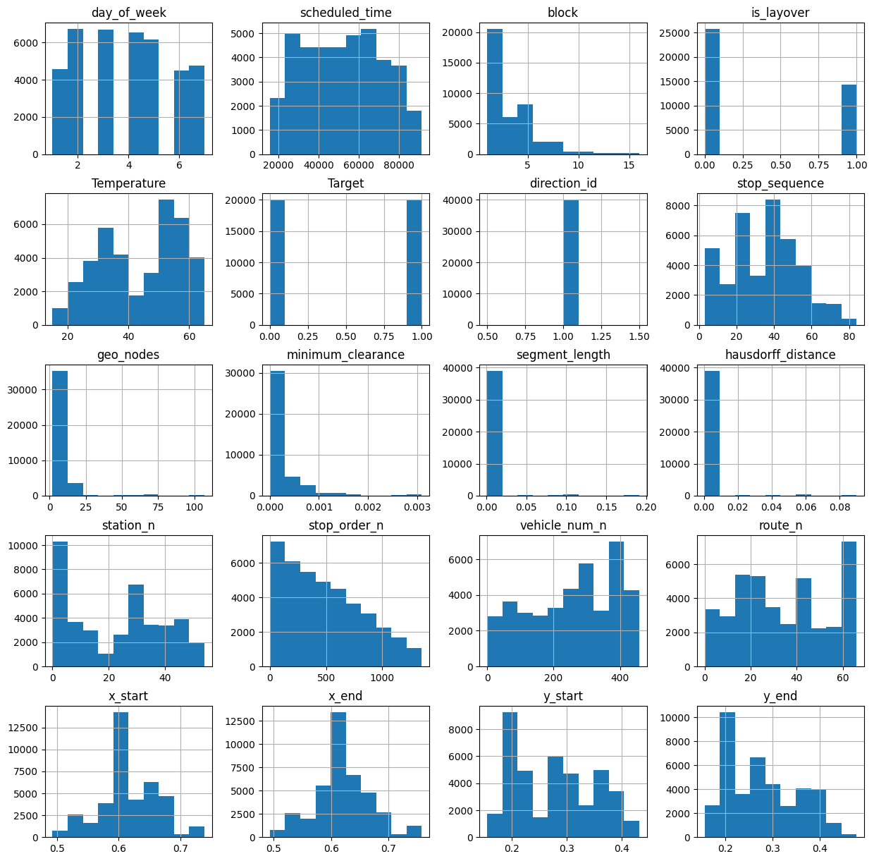

Slide 25
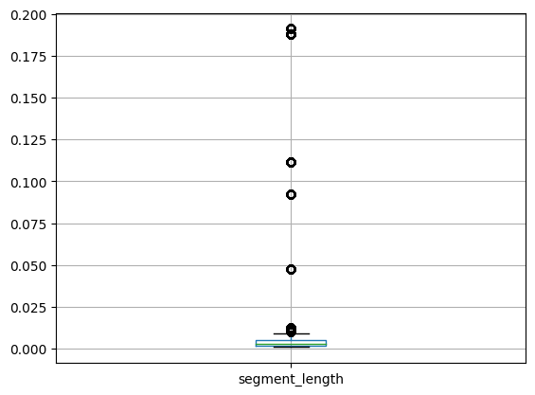
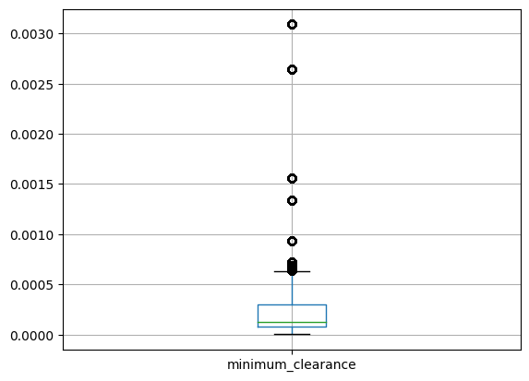
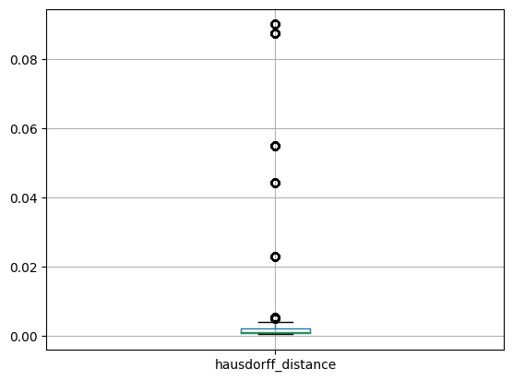
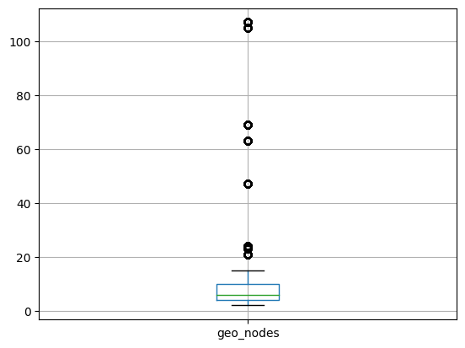

Slide 26
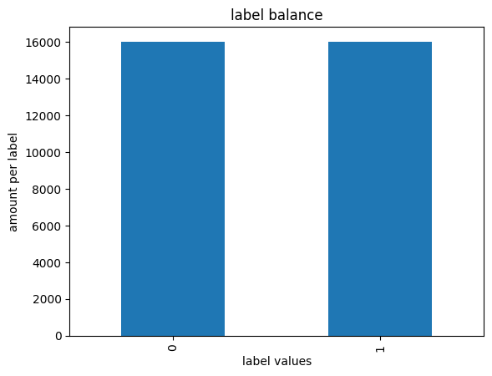
Training and Testing Sets
Balanced Data
80% Training
20% Testing

Slide 27
Modeling
Approach

Slide 28
Machine Learning
We Used the following ML models with 2 data sets with several iterations of hypertuning:
Logistic Regression
Support Vector Machines
K Nearest Neighbors
Decision Trees
Gradient Booster Tree Classifier
Random Forests
+ Hypertuning

Slide 29
Modeling
Logistic Regression – Support Vector Machines

Slide 30
Logistic Regression and SVM
Machine learning models, famous for binary classification
1
1
0
Logistic Regression
SVM
0

Slide 31
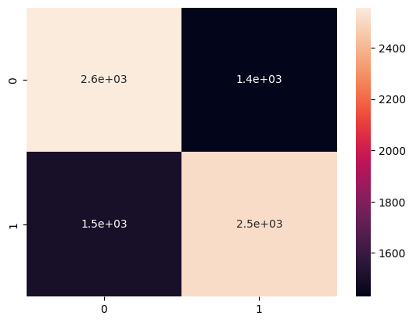
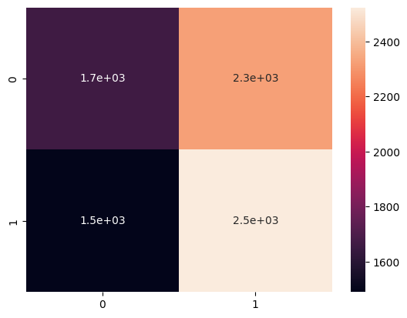
Logistic Regression SVM
Accuracy | Precision | F1- score
0.63 | 0.63 | 0.63
Accuracy | Precision | F1- score
0.52 | 0.52 | 0.52

Slide 32
Modeling
KNN

Slide 33
KNN
What is KNN
The k-nearest neighbors (KNN) algorithm is a data classification method used in estimating the likelihood that a data point will become a member of one group or another based on which group the data points nearest to it belong to.
Here k is the parameter that determines the number of nearest neighbours.
Why To use KNN
Classification is a critical problem in data science and machine learning. The KNN is one of the oldest yet accurate algorithms used for pattern classification and regression models.

Slide 34
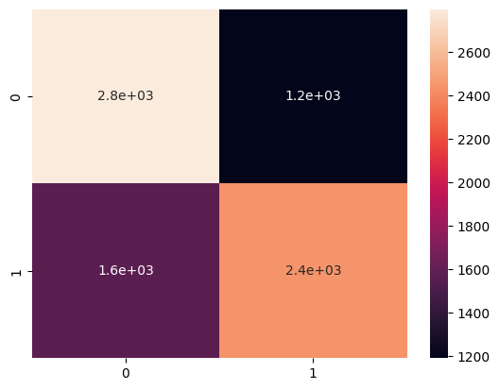
KNN
Accuracy | Precision | F1- score
0.75 | 0.75 | 0.75
Performance Metrics for dataset 2:
Confusion Matrix:

Slide 35
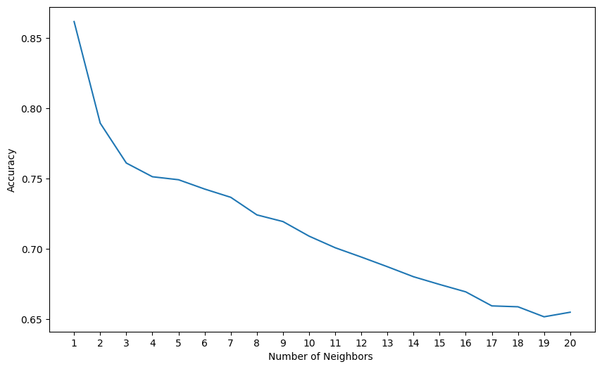
Hyperparameter tuning
Best Parameters:
{'metric': 'manhattan', 'n_neighbors': 3, 'weights': 'distance'}
When dealing with a two-class problem, it's better to choose an odd value for K. Otherwise, a scenario can arise where the number of neighbors in each class is the same. Also, the value of K must not be a multiple of the number of classes present

Slide 36
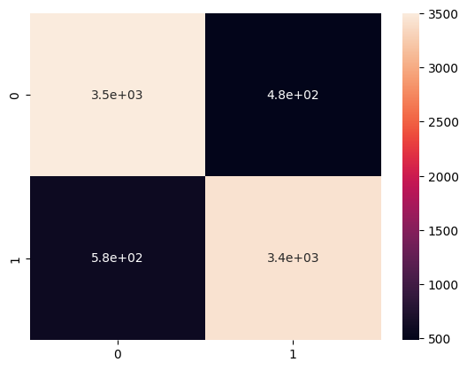
Hyperparameter tuning
Accuracy | Precision | F1- score
0.867 | 0.879 | 0.87
Performance Metrics for dataset 2:
Confusion Matrix:

Slide 37
Modeling
Decision Tree

Slide 38
Decision Tree
What is Decision Tree?
A decision tree is a non-parametric supervised learning algorithm, which is utilized for both classification and regression tasks.
Gini Index, Entropy and Information Gain are the most popular methods.
Why Decision Tree on MARTA dataset?
it handles skewed classes which suits well for our dataset which is a non-linear.
less effort for data preparation during pre-processing and it is not necessary to normalize or scale the data.
intuitive and easy to explain

Slide 39
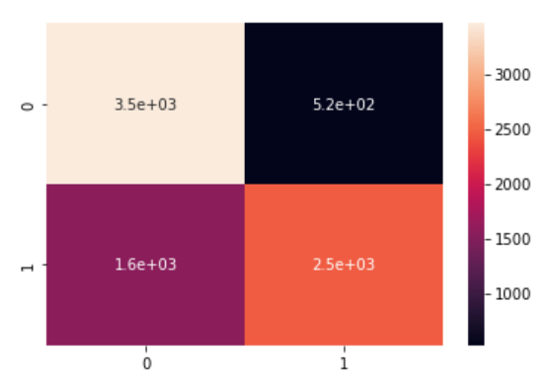
Decision Tree: Evaluation Metrics for Entropy
Accuracy | Precision | F1- score
0.74 | 0.86 | 0.70
Performance Metrics for dataset 2:
Confusion Matrix:

Slide 40
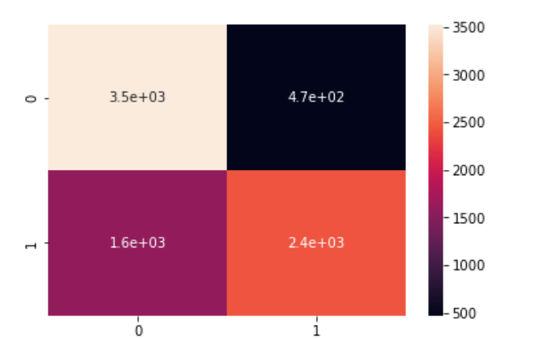
Decision Tree: Evaluation Metrics for GINI Index
Accuracy | Precision | F1- score
0.753 | 0.835 | 0.70
Performance Metrics for dataset 2:
Confusion Matrix:

Slide 41
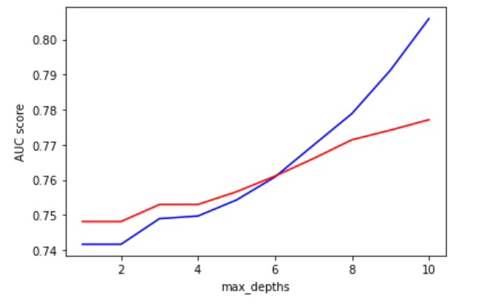
Hyperparameter tuning – max_depth
Hyperparameter used: max_depth which represents maximum depth of a tree.
From the below graph the max_depth of 9 to 10 will make the model better.

Slide 42
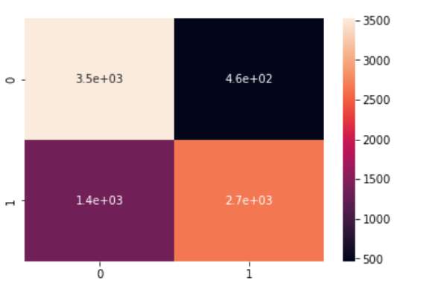
Hyperparameter tuning – max_depth
Accuracy | Precision | F1- score
0.773 | 0.884 | 0.75
Performance Metrics for dataset 2:
Confusion Matrix:

Slide 43
Decision Tree - Disadvantages
Decision Trees are instable because a small change in the data can cause a large change in the structure of the decision tree.
Sometimes calculation can go far more complex compared to other algorithms.
Decision tree often involves higher time to train the model.
The Decision Tree algorithm is inadequate for applying regression and predicting continuous values.

Slide 44
Modeling
Gradient Boosting

Slide 45
Gradient Boosting
Residual
Residual
Residual
(Sequentially)

Slide 46
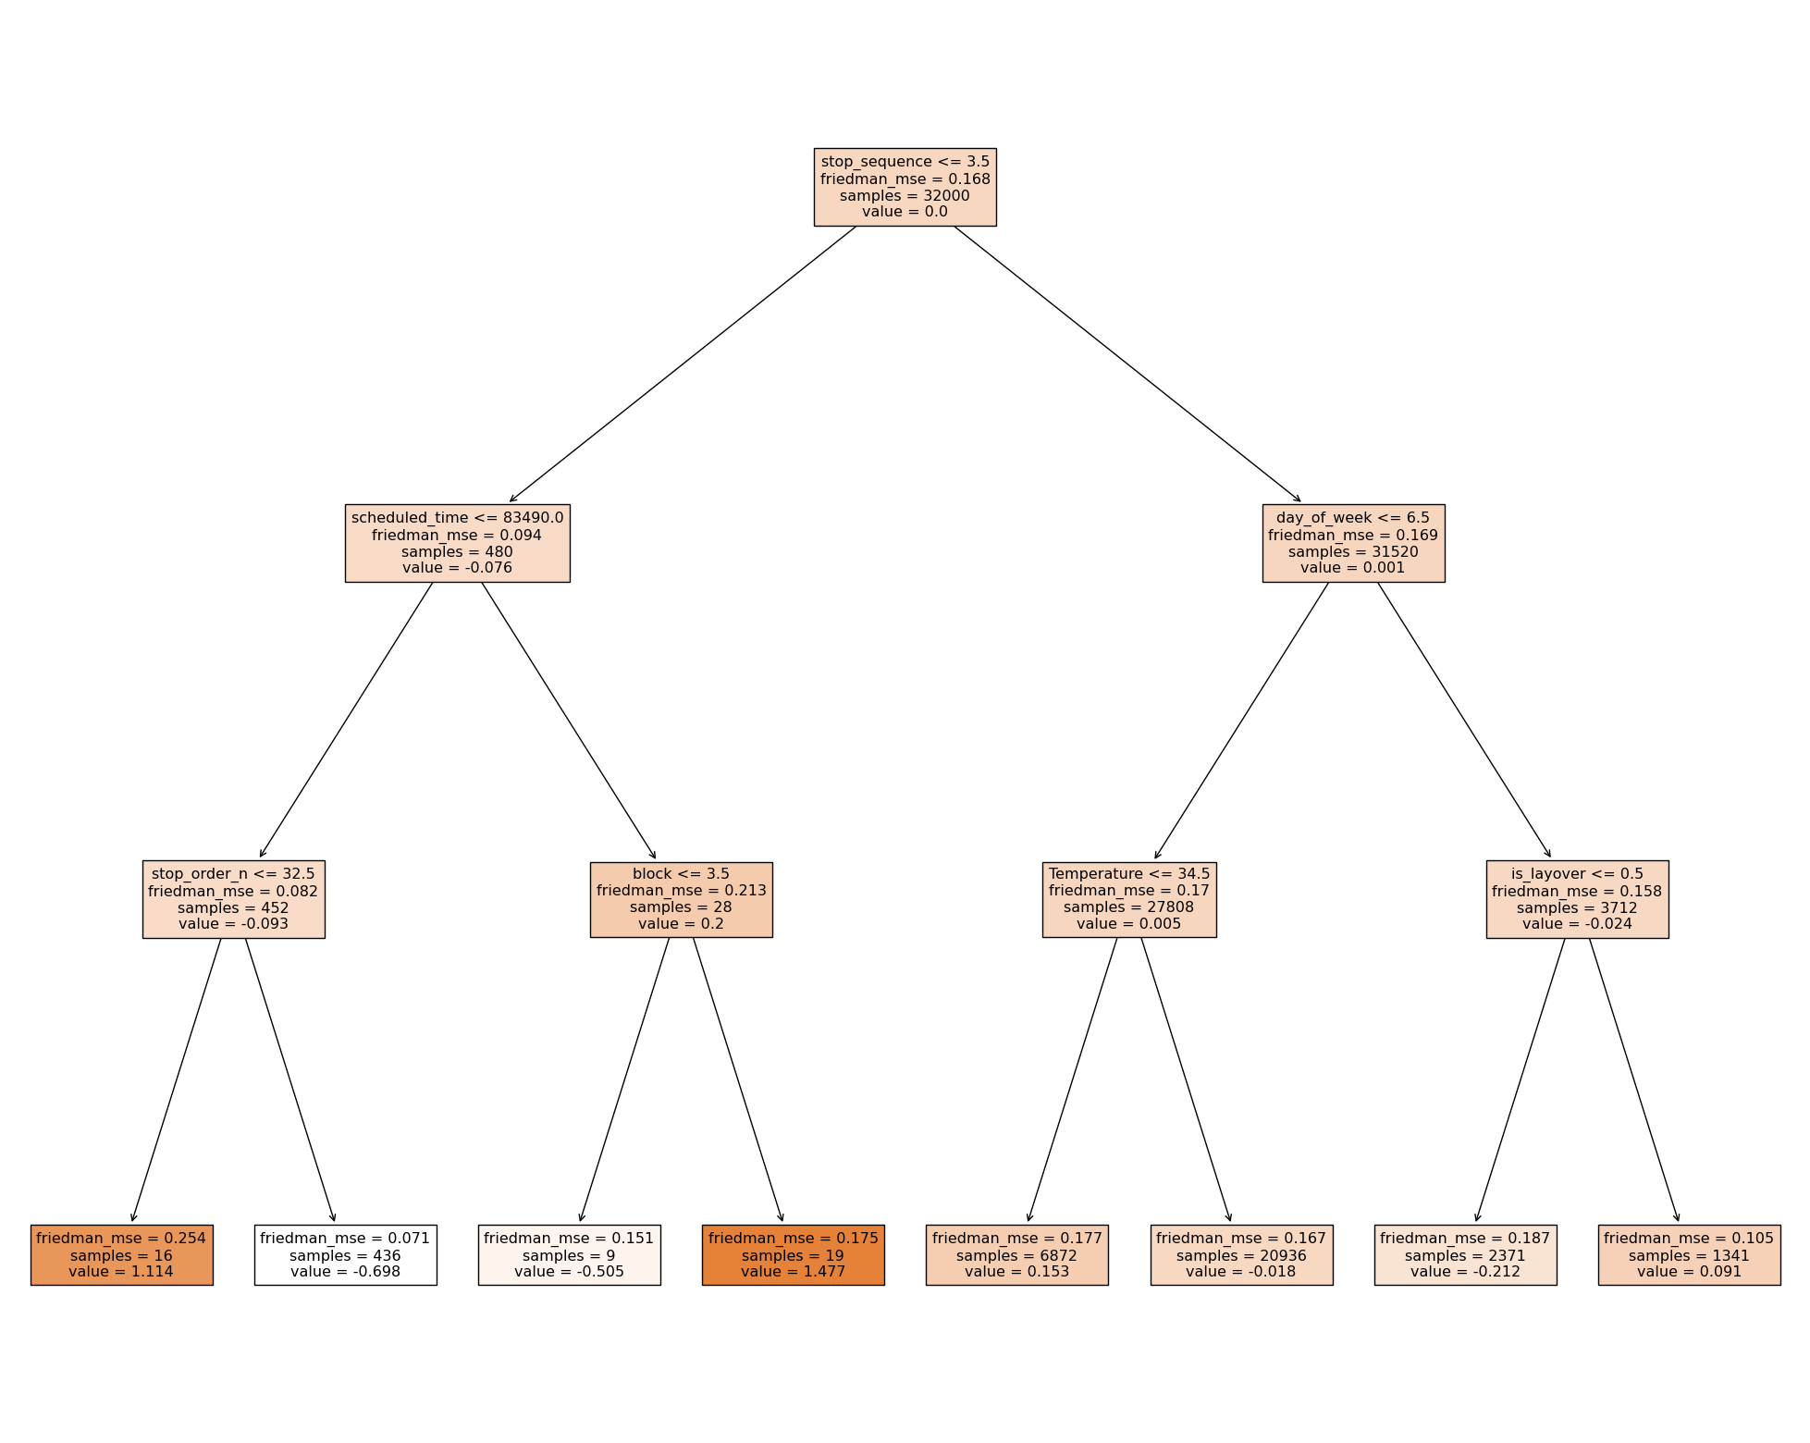
Gradient Boosting

Slide 47
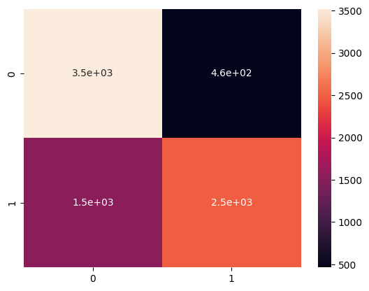
Gradient Boosting
Accuracy | Precision | F1- score
0.75 | 0.77 | 0.75

Slide 48
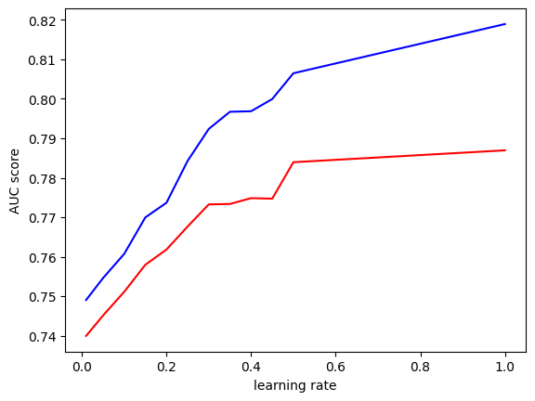
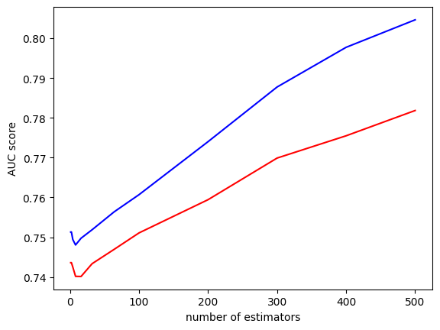
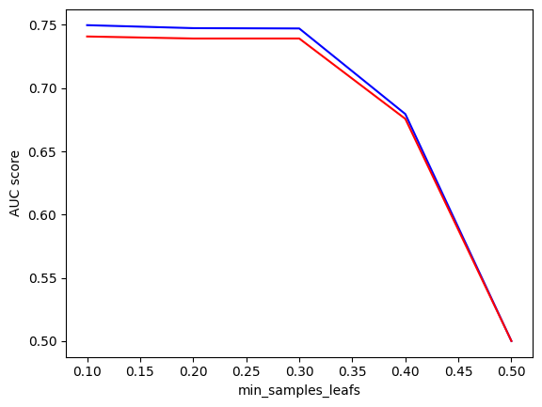
Hypertuning
learning_rate=1, n_estimators=500, min_samples_leafs=10

Slide 49
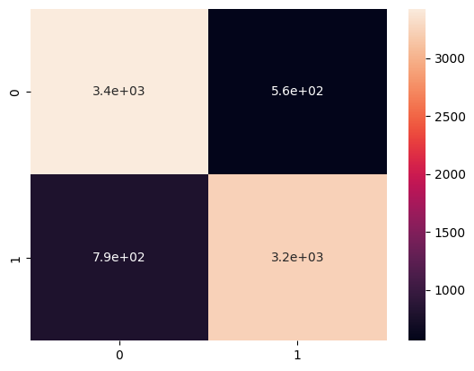
Hypertuning
Accuracy | Precision | F1- score
0.83 | 0.83 | 0.83

Slide 50
Modeling
Random Forest

Slide 51
Random Forest Classifier
What is Random Forest Classifier?
Random forest is a Supervised Machine Learning Algorithm that is used widely in Classification and Regression problems.
It builds decision trees on different samples and takes their majority vote for classification and average in case of regression.
In the random forest classifier, the higher the number of trees in the forest results in higher accuracy.
It is an ensemble method which is better than a single decision tree because it reduces the over-fitting by averaging the result.
Why Random Forest Classifier on MARTA dataset?
Random forests work well for a large range of data items than a single decision tree does.
Random Forest algorithms maintains good accuracy even a large proportion of the data is missing.
It overcomes the problem of overfitting by averaging or combining the results of different decision trees.
It overcomes the problem of overfitting by averaging or combining the results of different decision trees.

Slide 52
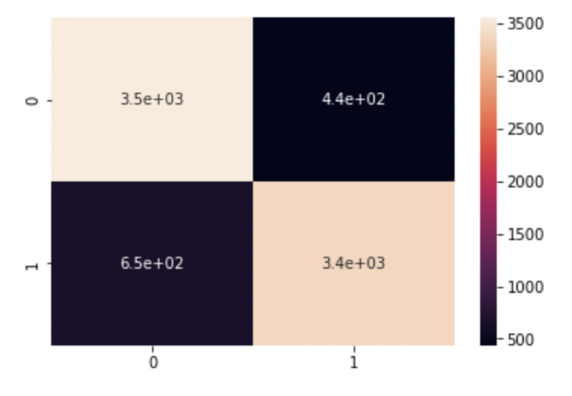
Random Forest: Evaluation Metrics for Entropy
Accuracy | Precision | F1- score
0.864 | 0.89 | 0.86
Performance Metrics for dataset 2:
Confusion Matrix:

Slide 53
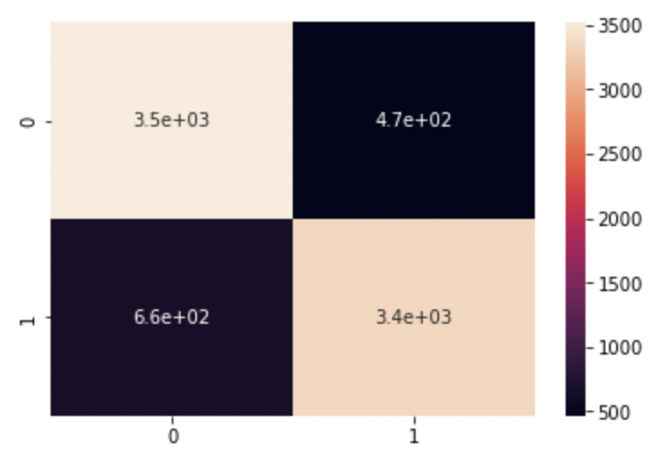
Random Forest : Evaluation Metrics for GINI Index
Accuracy | Precision | F1- score
0.859 | 0.883 | 0.86
Performance Metrics for dataset 2:
Confusion Matrix:

Slide 54
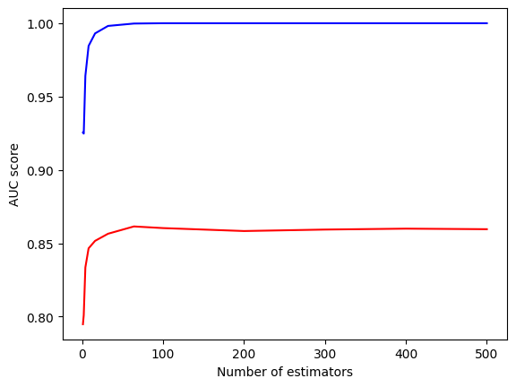
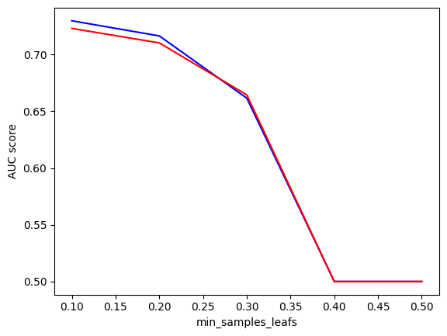
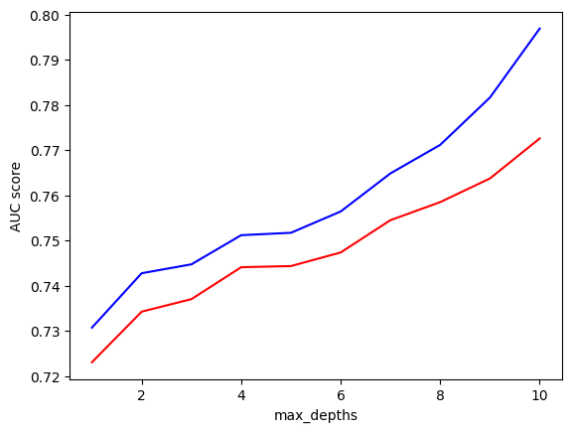
Hypertuning

Slide 55
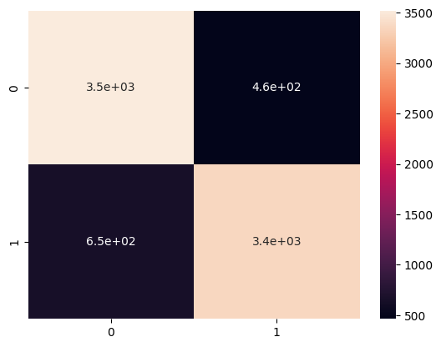
Hypertuning - None
Accuracy | Precision | F1- score
0.86 | 0.86 | 0.86

Slide 56
Random Forest Classifier - Disadvantages
Complexity is the main disadvantage of Random forest algorithms.
Construction of Random forests are much harder and time-consuming than decision trees.
More computational resources are required to implement Random Forest algorithm.
It is less intuitive in case when we have a large collection of decision trees.
The prediction process using random forests is very time-consuming in comparison with other algorithms.

Slide 57
Results

Slide 58
Results Table – Hypertuned
ML Model | Accuracy | Precision | F1- score
Logistic Regression | 0.63 | 0.63 | 0.63
Support Vector Machine | 0.52 | 0.52 | 0.52
K Nearest Neighbors | 0.87 | 0.87 | 0.87
Decision Trees
Gradient Boosting Classifier | 0.83 | 0.83 | 0.83
Random forest | 0.86 | 0.86 | 0.86

Slide 59
Key Takeaways

Slide 60
Best Model
First level

Slide 61
Impact

Slide 62
MARTA
Schedule trips around lateness
Notify Riders using their existing APP

Slide 63
Riders
Increase confidence with public transportation
Properly plan trips

Slide 64
Questions ?

